Slide 1


CHANDIGARH UNIVERSITY MOHALI PUNJAB, 140413
OTP Verification Using Python
Master of Computer Application
(UIC)
Winning Camp
01-07-2022
Project
Developed By:
Md Afzal Ali
21MCA2574

Slide 2

OTP Verification Using Python
Description-----
One-Time Passwords, or OTPs, are special codes that are delivered to your ID in order to confirm your identity as the user and finish the online transaction.
When doing online transactions or sometimes to authenticate your devices in the event that you forget your password or in similar circumstances, we make use of OTP.
OTP is therefore typically used to confirm that you are a registered user and to finish the task you are working on.

Slide 3
Used Module/Python Library
from curses import *
from twilio.rest import Client
import random
from tkinter import *
from tkinter import messagebox

Slide 4
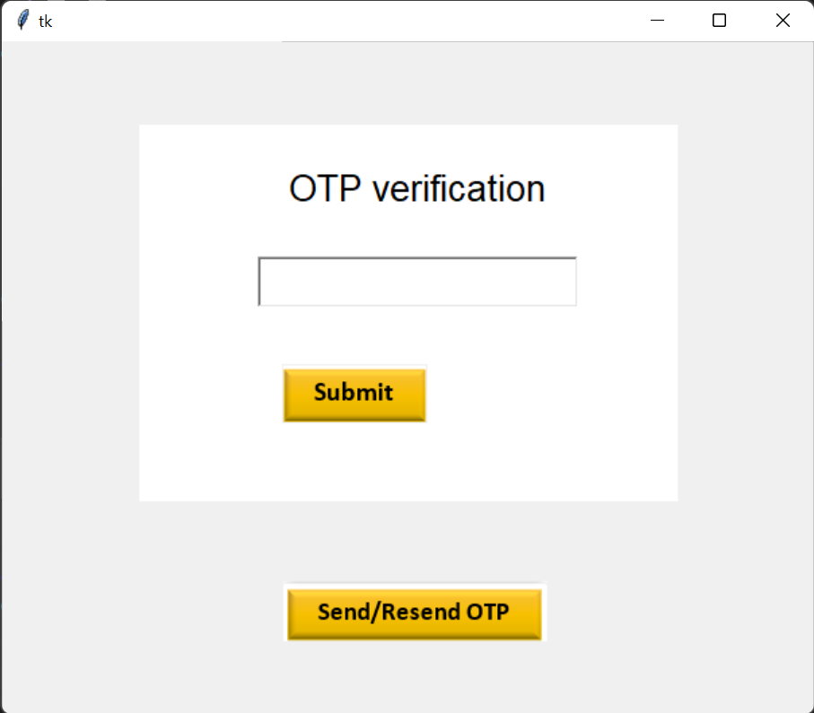
Project Result Interface
Click here for OTP

Slide 5
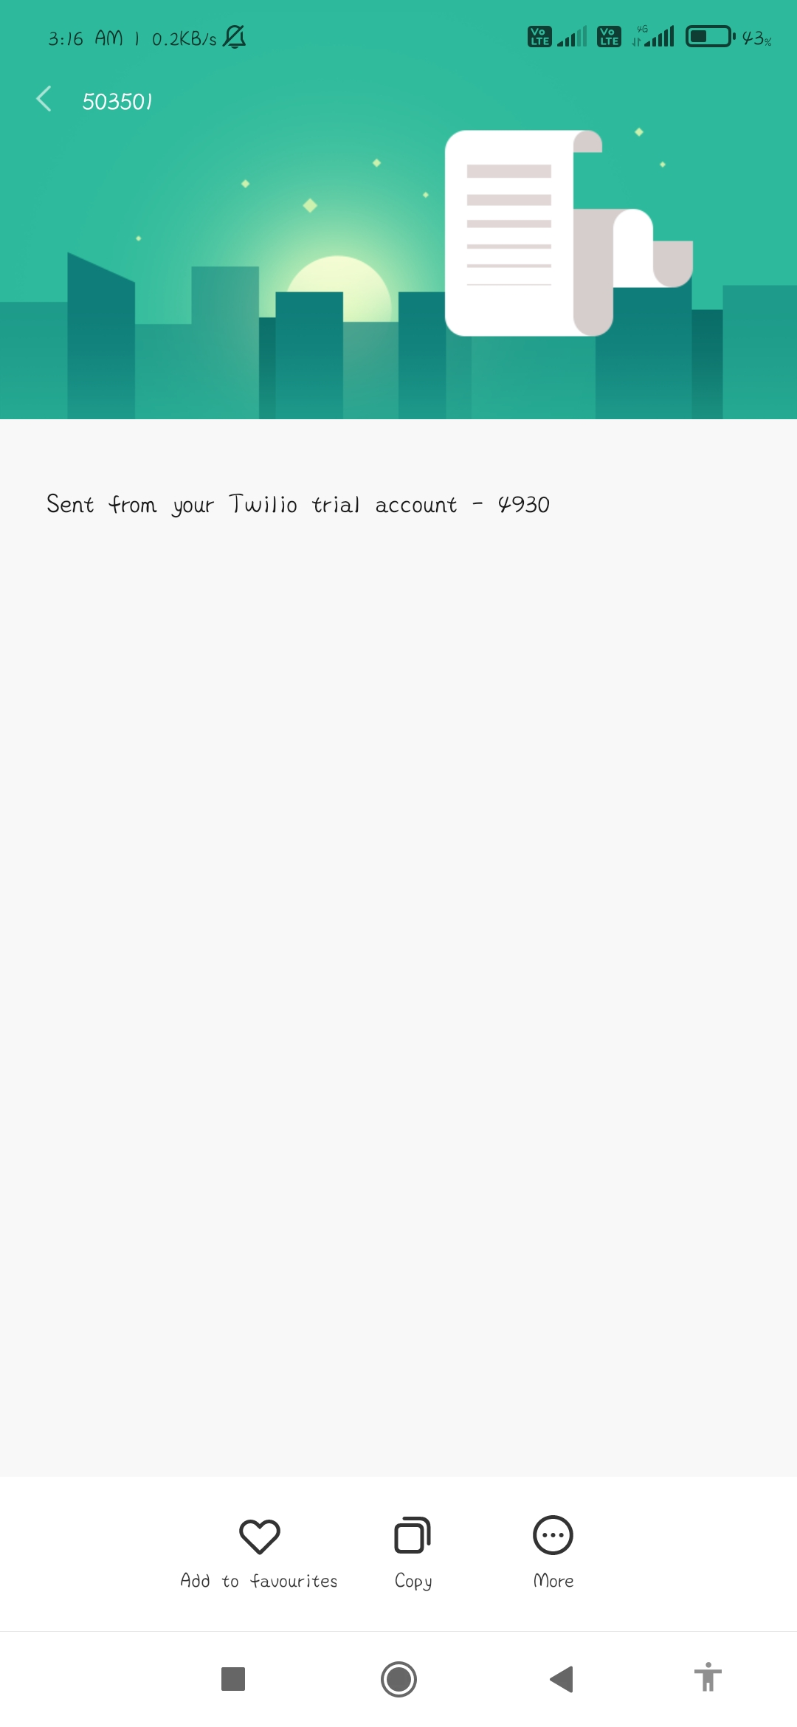
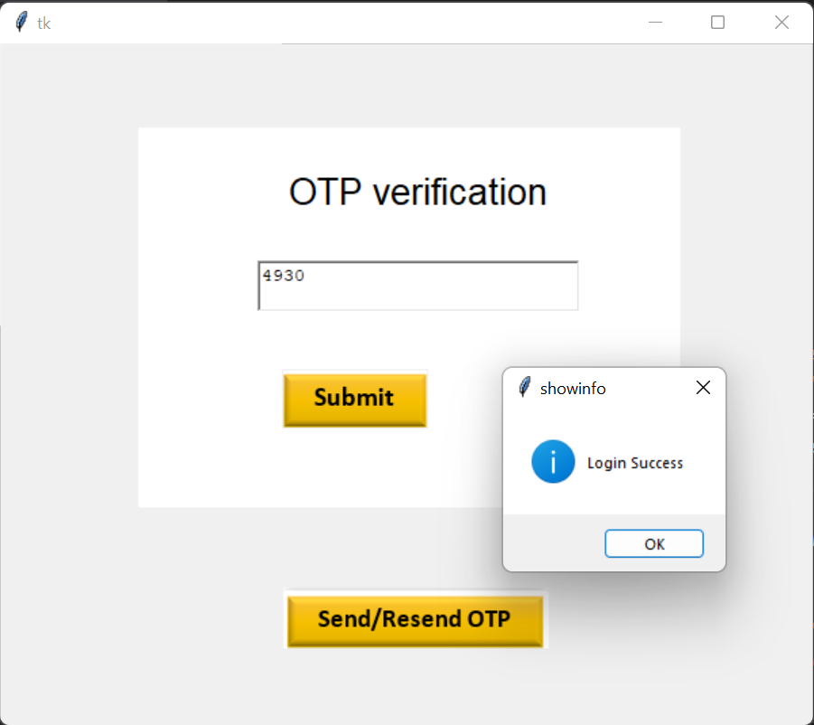
Project Result Interface
Login Success after enter the OTP
OTP Received on phone no.

Slide 6
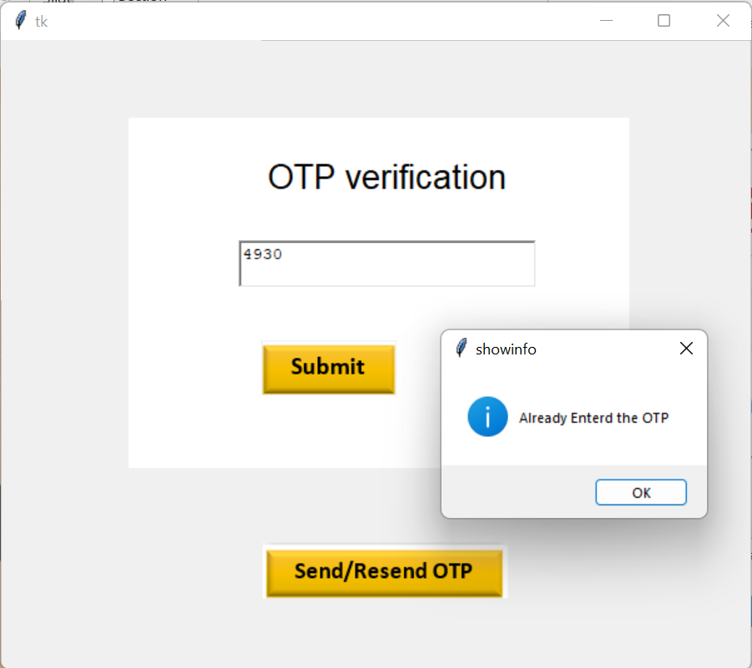
Project Result Interface
If you re-click on submit with OTP

Slide 7

Thank You--

